Slide 1

Klebsiella pneumoniae
Transcriptome Analysis of WT and dskA Mutant
Cassie Haakma

Slide 2
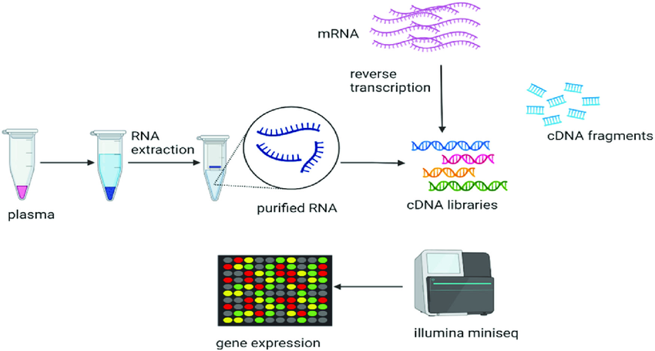
Transcriptome Analysis
Goals:
Assess sequencing quality
Align RNA-seq reads to a reference genome
Assemble transcripts
Quantify gene expression
Differential expression analysis
Visualize expression changes
Notes:
Transcriptome analysis examines all RNA transcripts expressed in a sample under specific conditions, compares gene expression differences between WT and mutant conditions, and identifies genes that are significantly upregulated or downregulated.

Slide 3
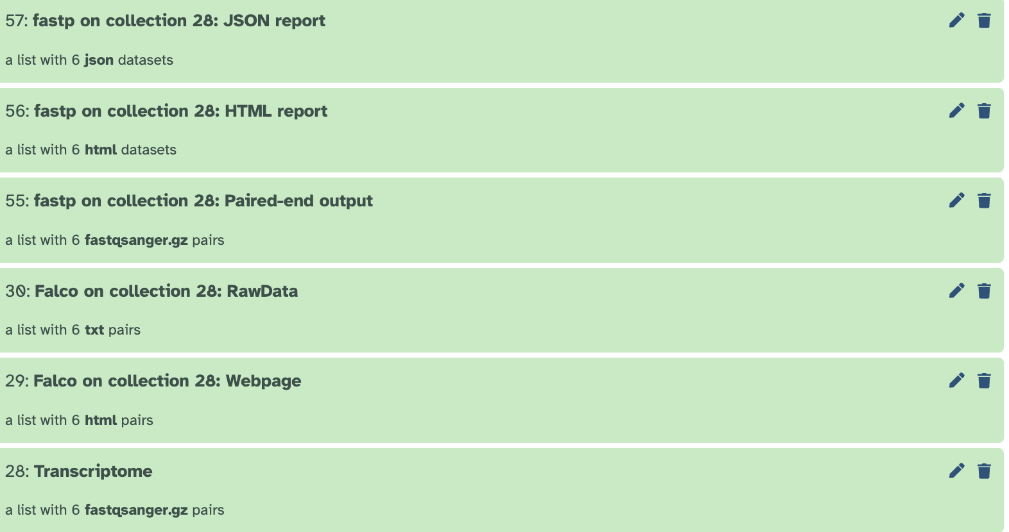
Quality Control and Read Processing
FastQC (Falco) - Quality assessment
Trimming (Fastp)
Importance:
Reduces sequencing errors
Produces more reliable/cleaner datasets
Notes:
Falco: Evaluates quality of raw transcriptome reads and spits out different metrics (base quality scores, GC content, sequence duplication, adapter contamination)
Fastp: Removes low-quality bases and adapter sequences
Imp: prevents false differential expression

Slide 4
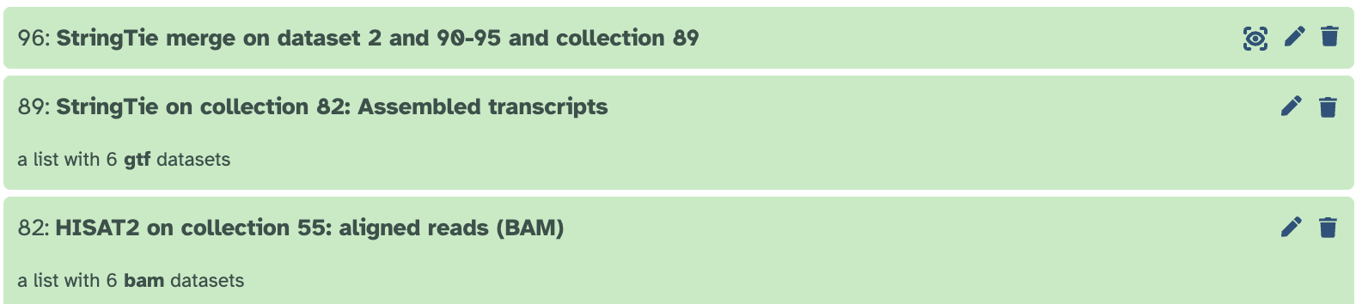
Alignment and Transcript Assembly
HISAT2: Reads alignment
StringTie: Produces GTF/GFF transcript
Importance:
IDs condition-specific gene expression
Reveals active genes/transcript variants
Notes:
Hisat: aligns cleaned reads to reference genome
Stringtie: assembles the RNA-seq reads into transcripts

Slide 5
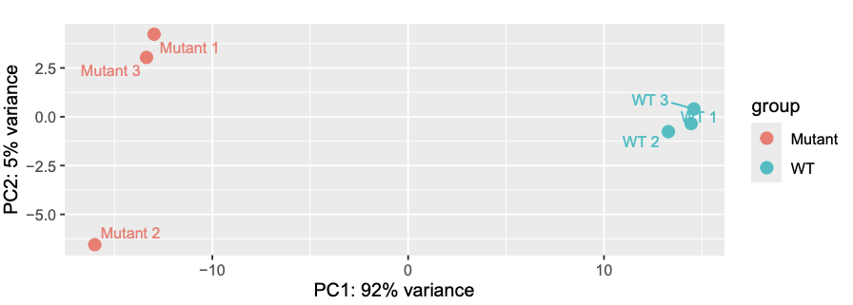
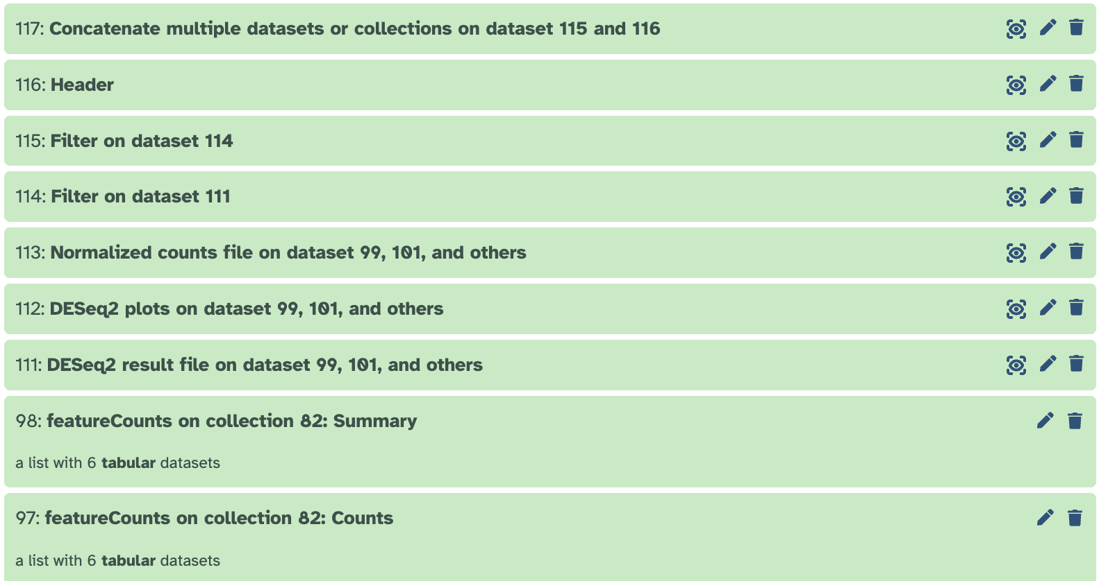
Differential Gene Expression Analysis
Quantification via FeatureCounts
DEseq2: Statistical analysis
Positive log2(FC) → Upregulated genes
Negative log2(FC) → Downregulated
P-adj < 0.05 indicates statistical significance
Notes:
Featurecounts: generate a gene expression matrix and to count reads mapped to each gene
DEseq2: Compares genes expression b/t WT and Mutant
P-values: Null = no difference in gene expression b/t mutant and WT. Alternative: Difference in gene expression b/t WT and mutant
PCA plot: PC1 on x-axis explains 92% of all variance in dataset. Y-axis explains an additional 5%. With that being 97%, almost all differences among samples are captured

Slide 6
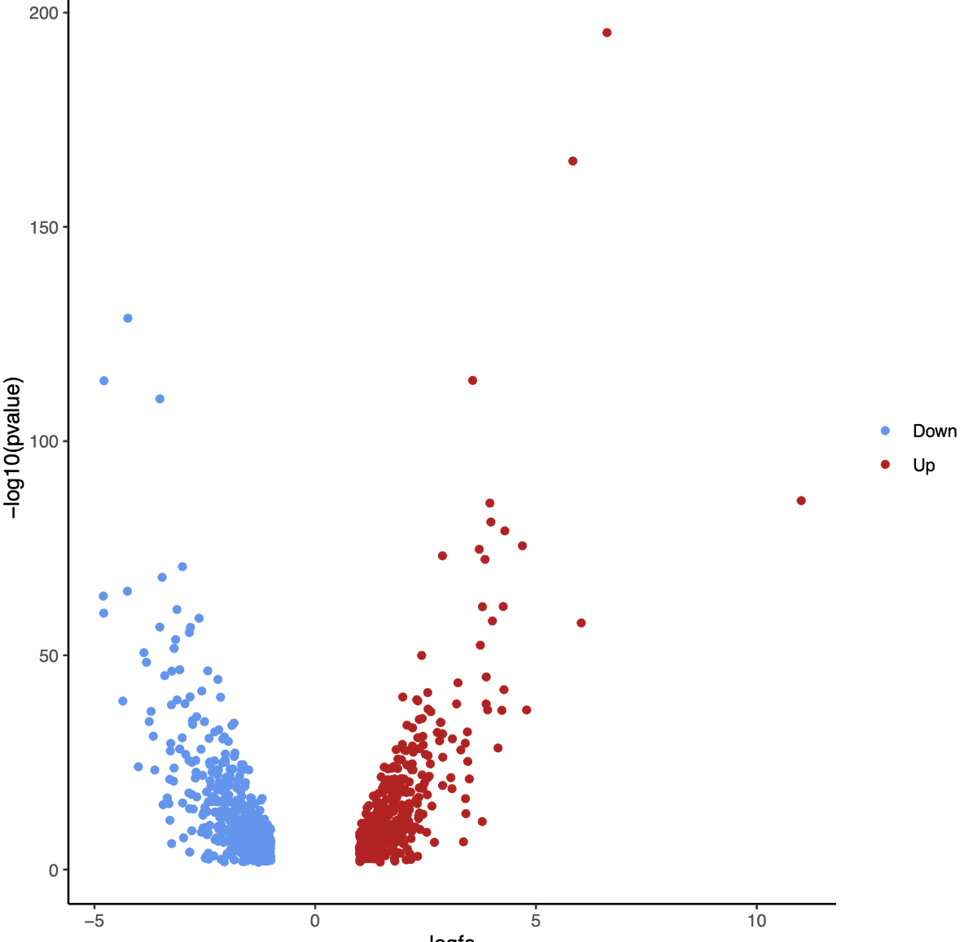
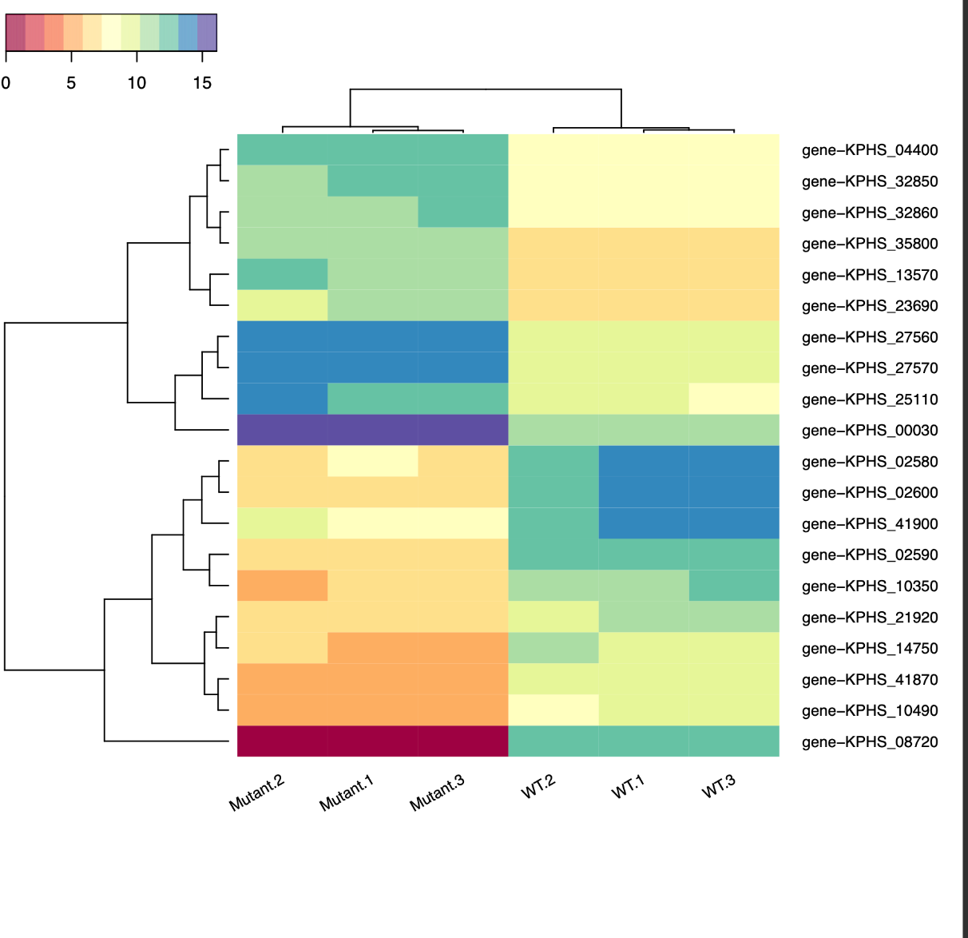
Data Visualization and Biological Interpretation
Volcano plot
Heatmap
Notes:
Volcano plot: Displays statistical significance vs. fold change, Highly significant genes appear at the top of the plot, Upregulated and downregulated genes are easily identified. Clustering represents that most genes are not significant. Genes toward top of graph = significant and biologically meaningful
Heatmap: Visualizes expression patterns across samples, genes with similar expression cluster together, helps identify biological pathways and sample relationships. Mutants cluster together and WTs cluster together. Some genes display opposite patterns in WT vs mutant. E.g. bottom two genes are highly expressed in mutant but not WT.

